Slide 1

Data Science Capstone Clusterting Toronto Boroughs
j
By Susan Nelson

Slide 2
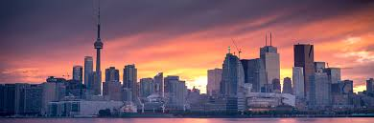
Business Case
Cluster Post Codes in the city of Toronto and merge with location data from Foursquare in order to provide hotels and similar establishments a relevant list of venues in their vicinity that their customers will be interested in patronizing on their stay.

Slide 3
Data/Sources
Wikipedia: for postal Code data
Geospacial data: for latitude and longitude data
Foursquare: for venue data

Slide 4
Methodology
Integrate Postal Code, Neighborhoods and Boroughs from Wikipedia
Integrate latitude and longitude data via Geospacial data set
Integrate Toronto venues via Foursquare API
Merge Cluster Data Set with Venue data
Create Clusters based on latitude and longitude data

Slide 5
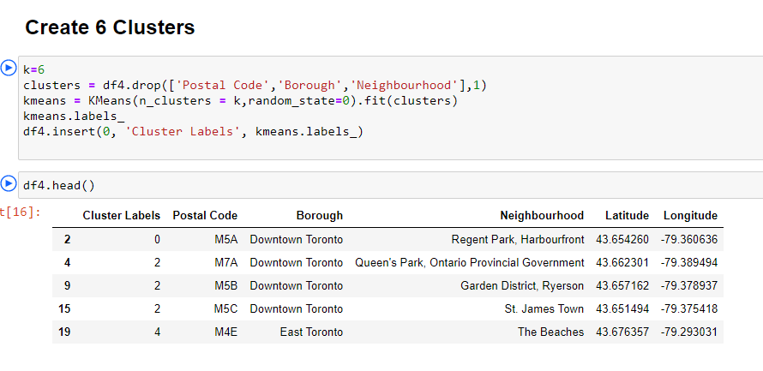
Results

Slide 6
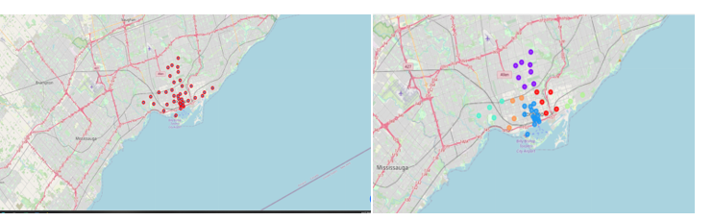
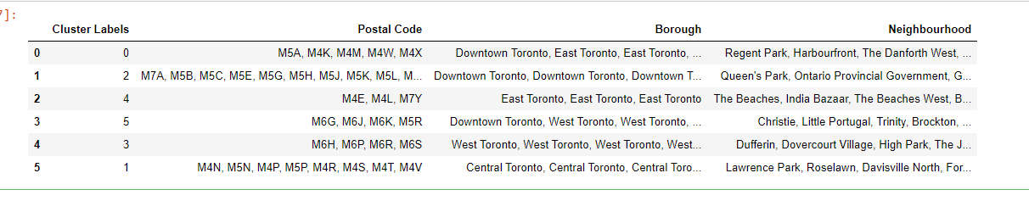
Results
Boroughs Un-Clustered
Boroughs Clustered

Slide 7
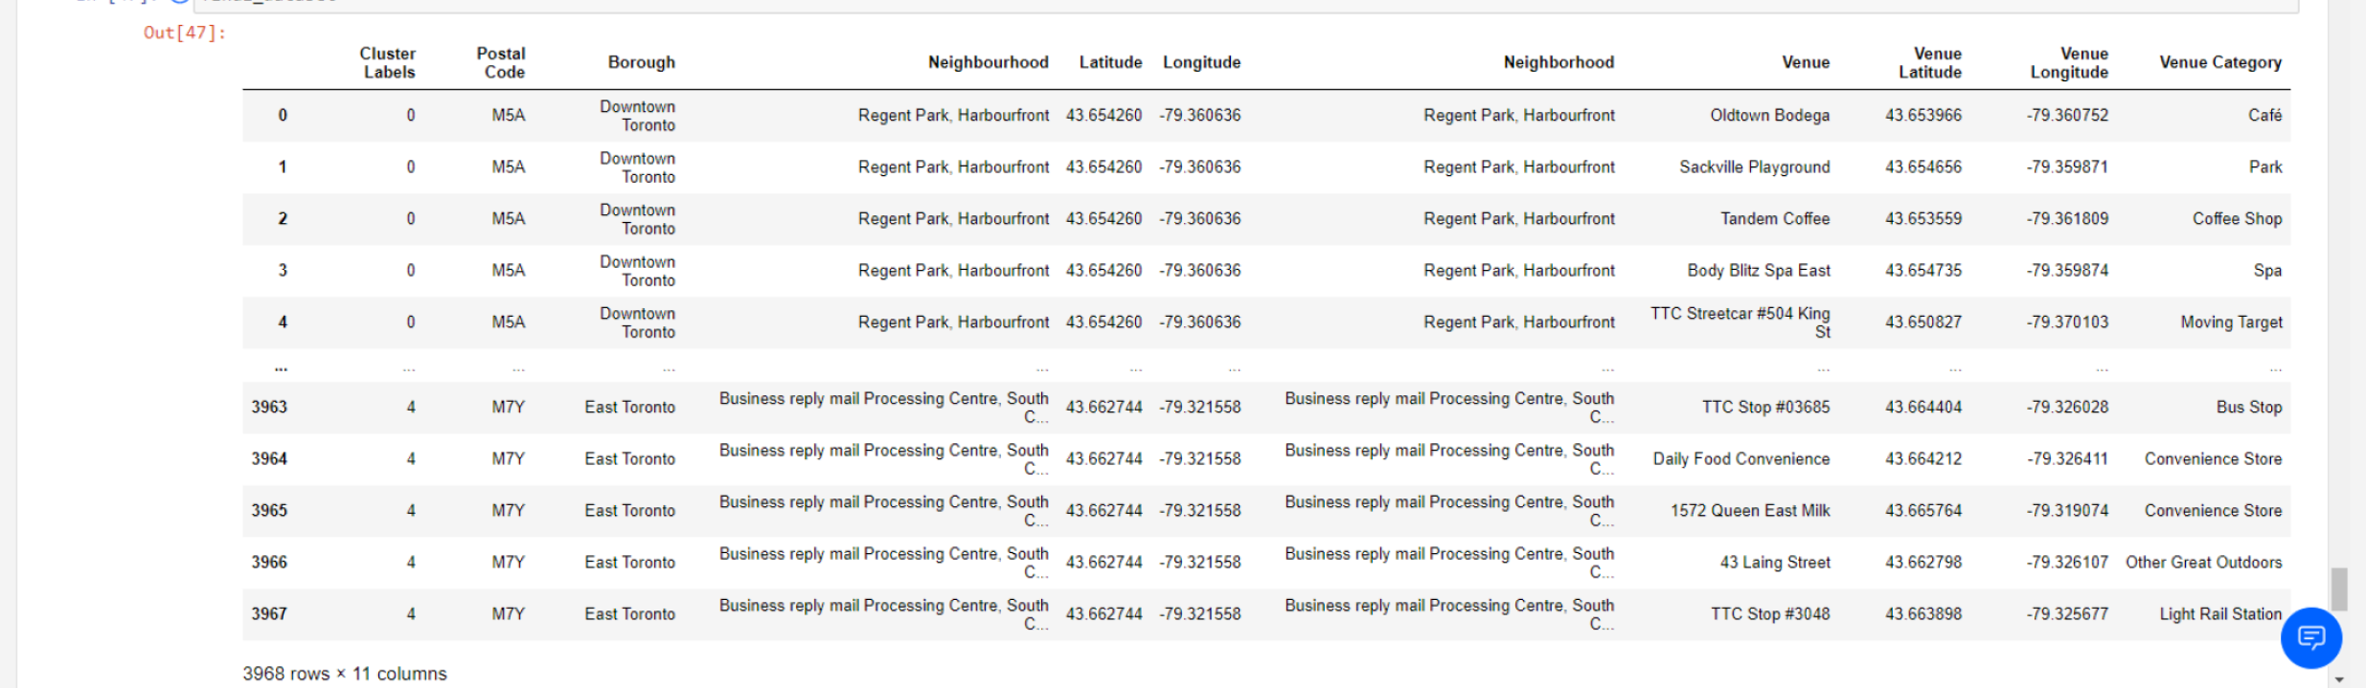
Results
Toronto venues and their corresponding clusters, borough, neighborhood, type, etc…

Slide 8
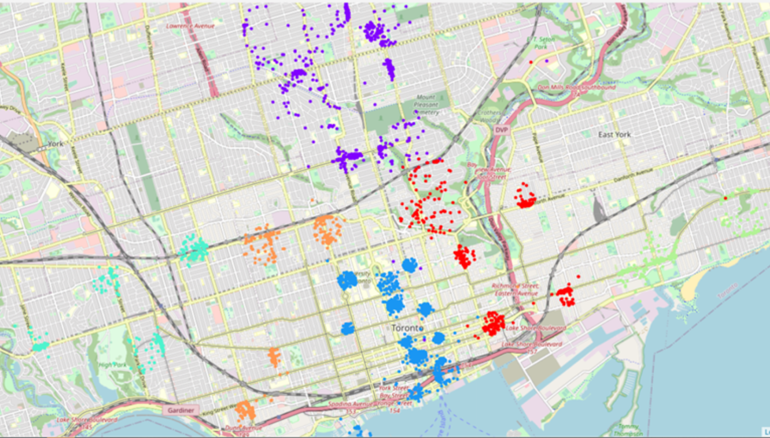
Results
Venues color coded by cluster

Slide 9
Recommendation
Offer this dataset as a subscription service for regularly updated results.
Add venue consumer ratings.
Create a venue recommendation engine
Change the number of clusters depending on customer requirements.
Package data together in the form of an app and be provided as a plug-in as extension to the hotel or other businesses website for a user to search

Slide 10
Conclusion
Vast amount of rich data can be obtained free sources
While many location and venue apps exists, there’s still untapped territory in terms of adding new features and enriching the data to benefit consumers/users.

